Slide 1



Ehsan Roohi
Mechanical and Industrial Engineering
University of Massachusetts Amherst
Machine Learning Accelerated Rarefied
Gas Dynamics Calculations Based on DSMC Dataset
Google Scholar
Email: roohie@umass.edu
APS-DFD, 11-23-2025

Slide 2

My YouTube Channel
https://www.youtube.com/@Ehsan_Roohi

Slide 3
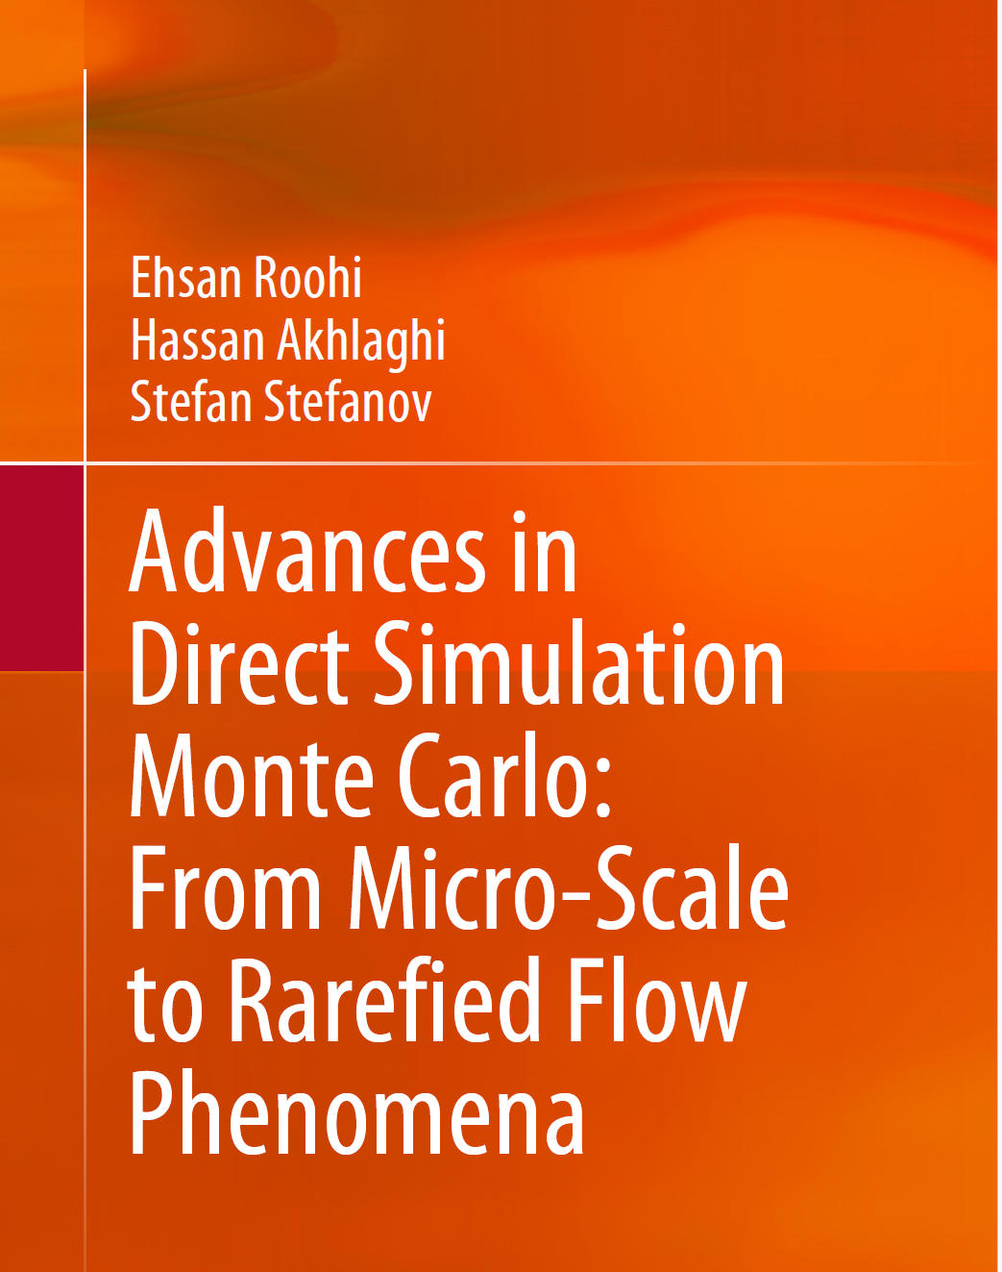
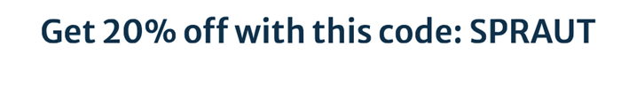
My Recent Book

Slide 4
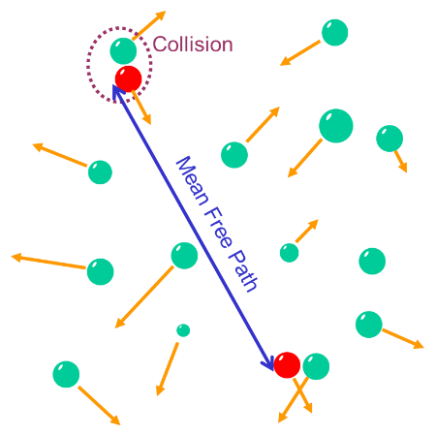
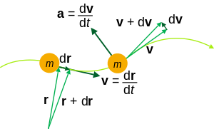

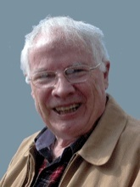

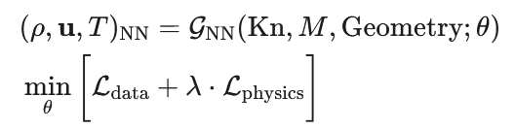
Problem Setup
Ground Truth: Boltzmann Equation
High-Fidelity Solver
Surrogate Model
Graeme Bird
G_{NN}: AI operator
L_{data}: Matches high-fidelity DSMC data
L_{physics}: Enforces physical laws (e.g., Zonal Loss for vortices, monotonicity for shocks)

Slide 5
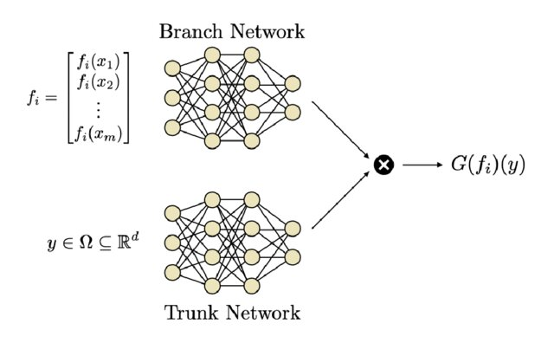
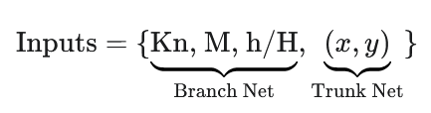
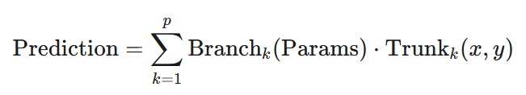
Our Solution: Physics-Aware Surrogate Modeling
Flow Field=DSMC brute-force ​(Parameters)
Flow Field≈Deep-O-Net-physics-aware​ (Parameters)
Trained with innovations like Zonal Loss & Physics-Enforced Constraints

Slide 6
(DeepONets): A New Paradigm
A Brief History: From Learning Functions to Learning Operators.
Origin: Introduced by Prof. Karniadakis' group (circa 2019-2021), based on the Universal Approximation Theorem for Operators.
The Conceptual Leap: Shifted the goal from learning a single function (y=f(x)) to learning an entire operator (G(u)(y)).
What is an Operator? An operator is a "rule" that maps an entire input function (e.g., a set of parameters) to an entire output function (e.g., a flow field).

Slide 7
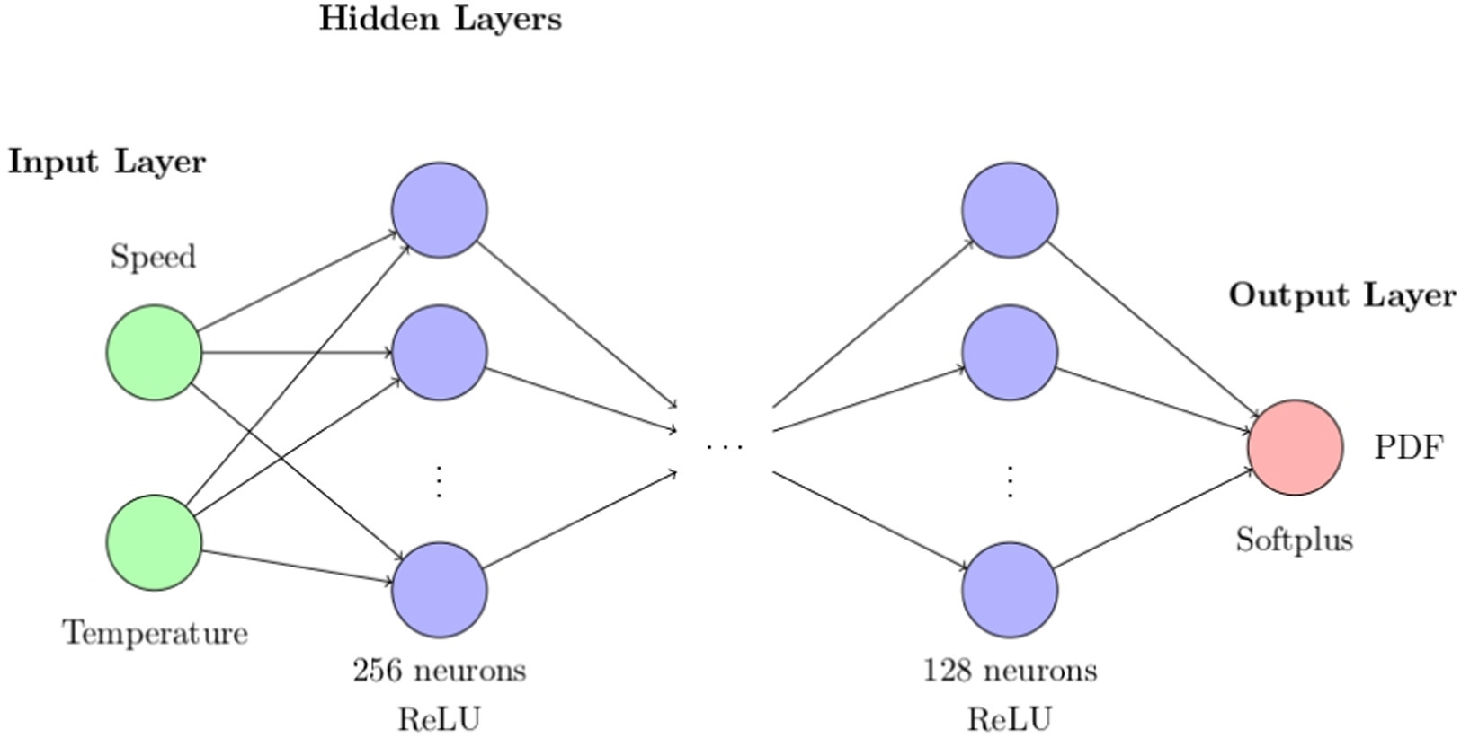
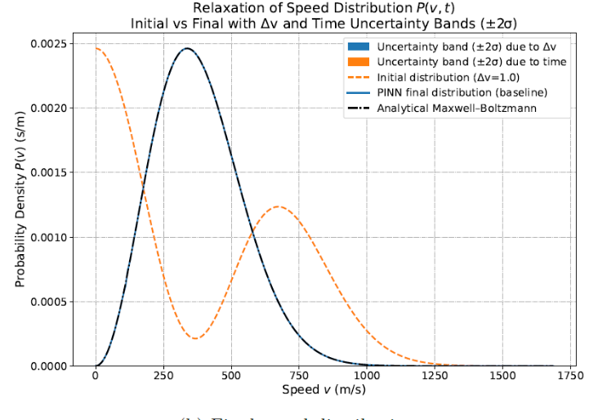
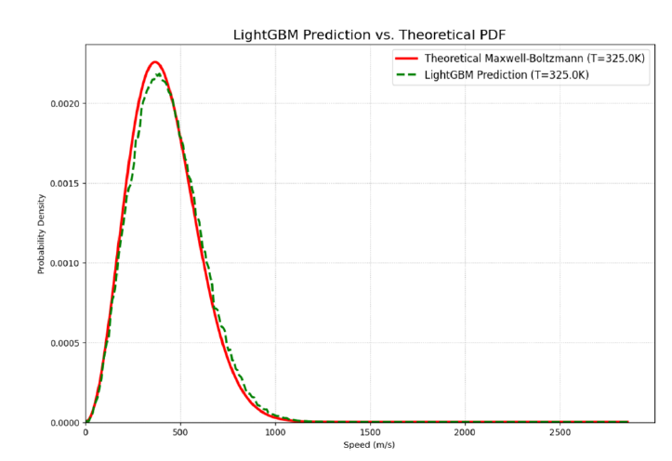
Can a Neural Network learn a Maxwell-Boltzmann distribution directly from DSMC?
The DNN significantly outperforms other standard ML models (like LightGBM, bottom plot), which struggle to capture the precise physics. This validates our choice of a deep learning approach
Notes:
Of course. Here is a concise summary in English comparing the two primary neural network strategies from your papers.
Comparison of Surrogate Modeling Strategies
Our research has explored two distinct and powerful strategies for developing surrogate models for rarefied gas dynamics, each suited for different challenges:
1. The "Family-of-Experts" with Log-Interpolation
This is a
"divide and conquer" approach, primarily used for the lid-driven cavity problem to handle a very wide range of Knudsen numbers (from 0.001 to 10)¹¹¹¹. Instead of training one large, complex model, we train several smaller,
specialist neural networks. Each "expert" model is trained on high-fidelity DSMC data for a single, fixed Knudsen number and becomes highly accurate for that specific regime². To make a prediction at an
unseen Knudsen number, the framework intelligently selects the two nearest "experts" and interpolates their predictions using a logarithmic scale to produce the final flow field³³³³. This modular approach is effective for spanning vast, multi-regime parameter spaces.
2. The Physics-Guided Deep Operator Network (DeepONet)
This is a more advanced, unified
"learn the operator" approach, developed for the micro-step and hypersonic cylinder flows⁴⁴⁴⁴. This method uses a single
Deep Operator Network (DeepONet) to learn the continuous mathematical operator that maps an input parameter (like Knudsen number or Mach number) to the entire 2D flow field⁵⁵⁵⁵. The key innovation in our work is the introduction of
physics-guided learning. For instance, we developed a novel
Zonal Loss function that forces the model to prioritize accuracy in physically critical regions, such as the recirculation vortex behind the micro-step, ensuring engineering-relevant features are captured with high fidelity⁶. This creates a single, powerful model that learns the underlying physics in a more holistic and intelligent way.
We have now designed a complete, in-depth narrative for your presentation. As a final step, would you like me to organize the structure we've created into a clean Table of Contents? This can serve as your final roadmap for building the presentation slides.

Slide 8
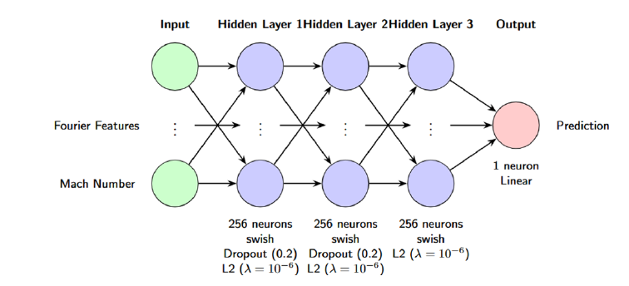
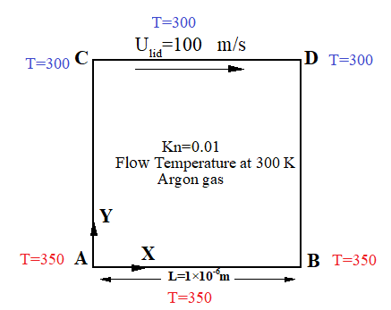
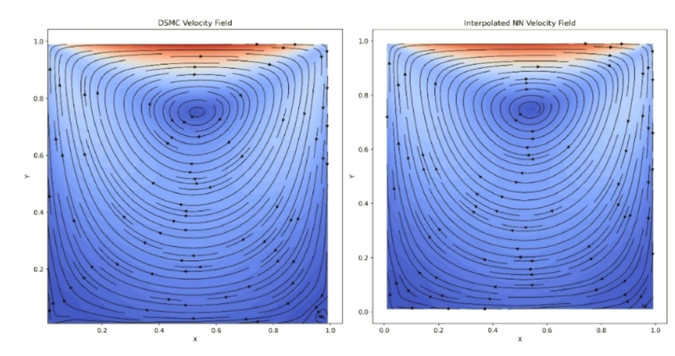
Cavity Problem and Validation
Roohi, E., & Shoja-Sani, A. (2026). Data-driven surrogate modeling of DSMC solutions using deep neural networks. Aerospace Science and Technology, 168(Part A), 110785.

Slide 9
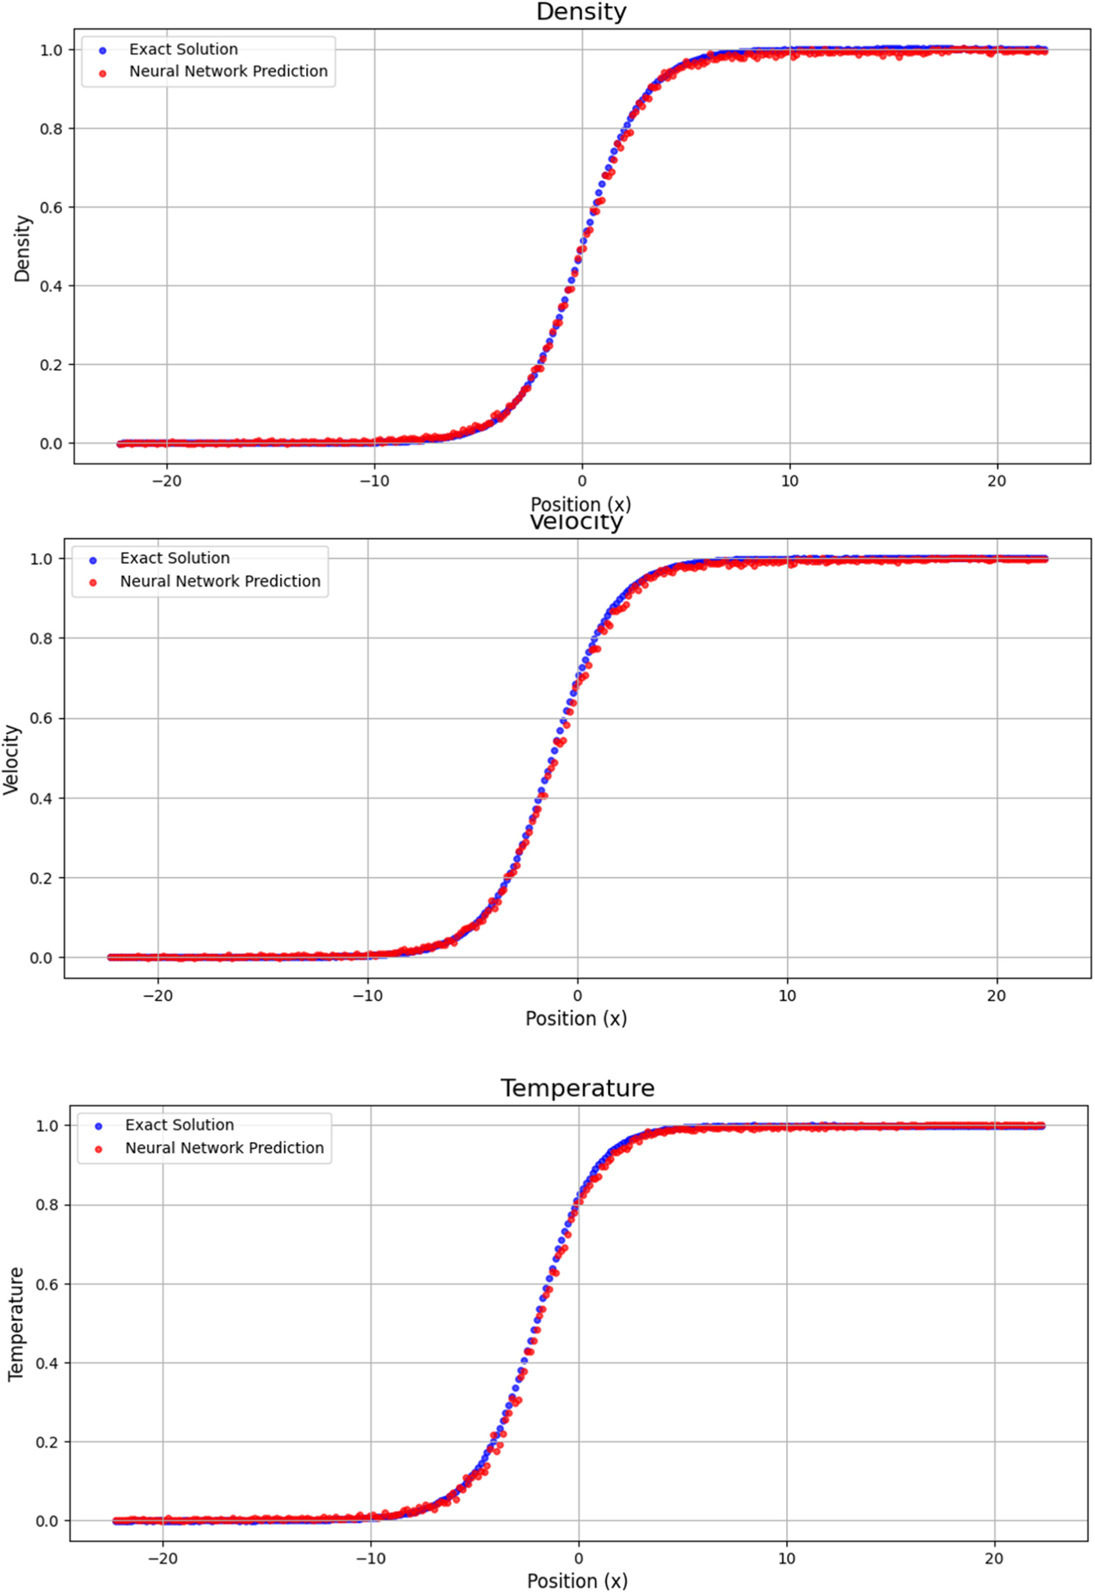
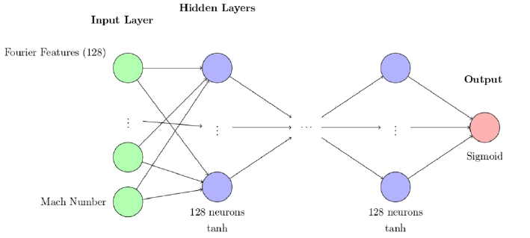
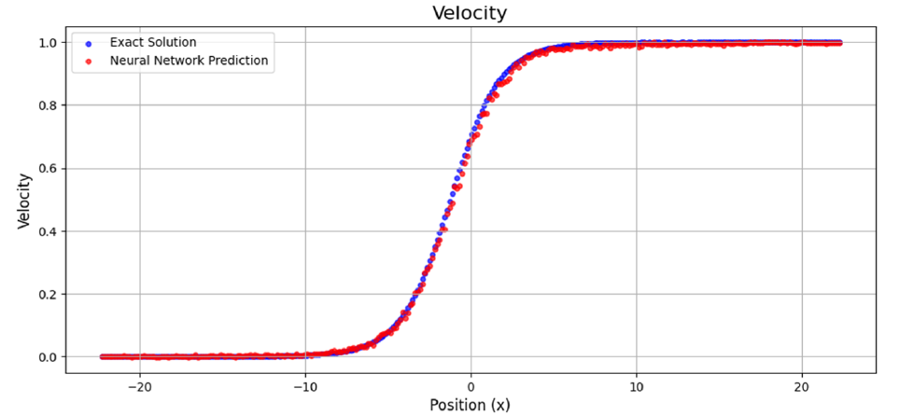
Mono-atomic Rarefied Shock Wave: Interpolation
Training Range: M=1.5-1.9
M=1.7

Slide 10
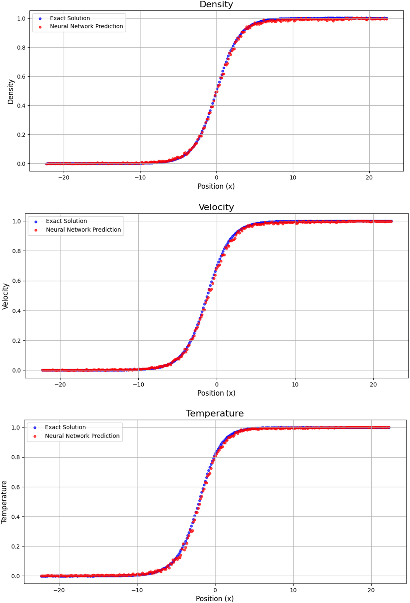
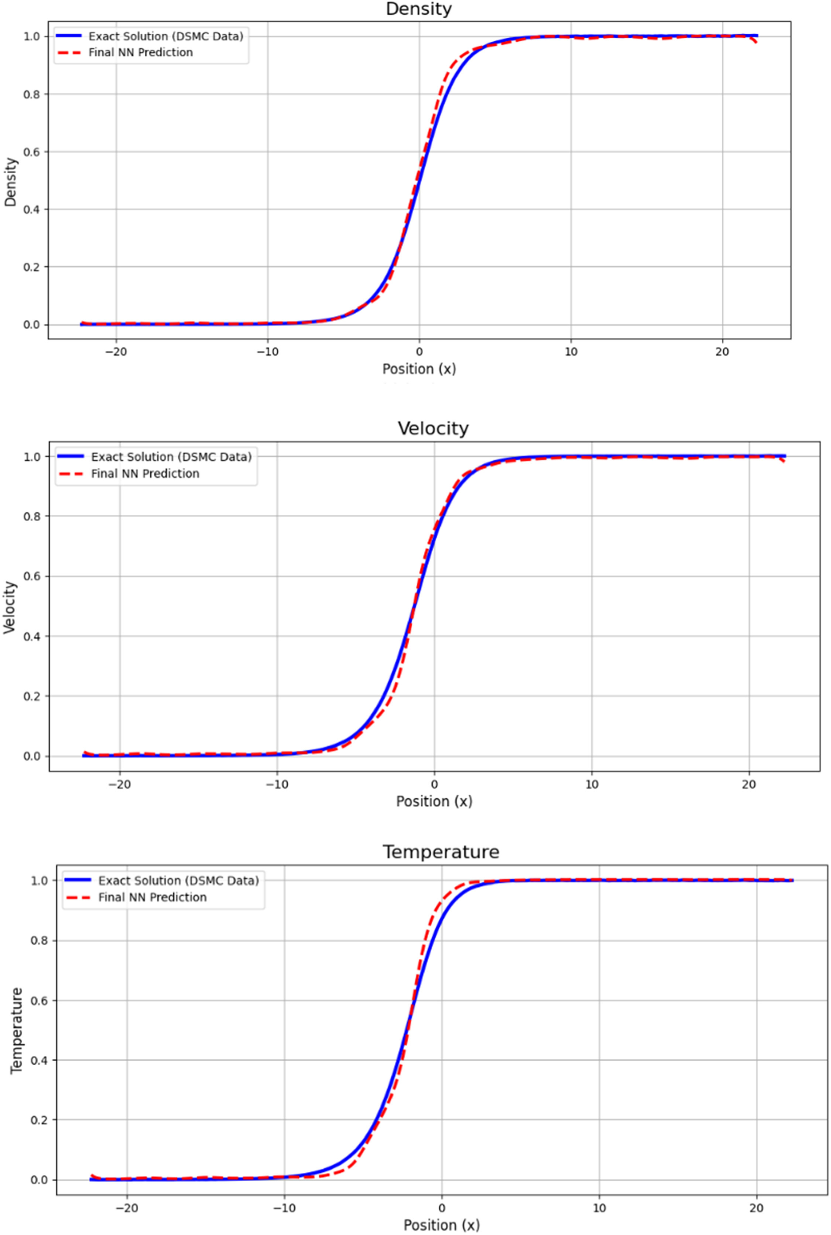
Mono-atomic Rarefied Shock Wave: Extrapolation
M=2
M=2.5

Slide 11
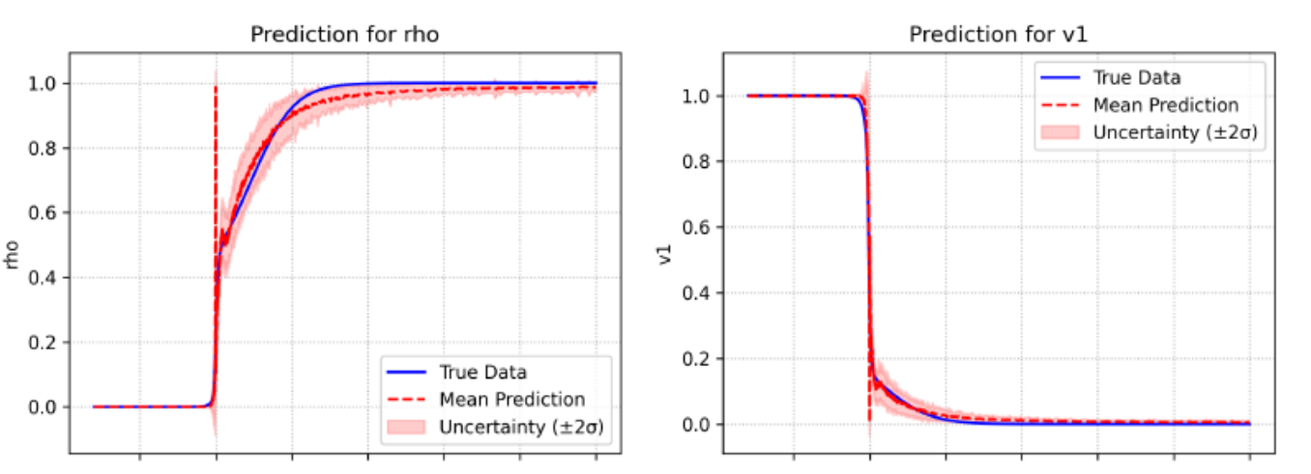
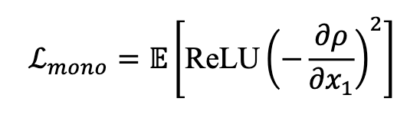


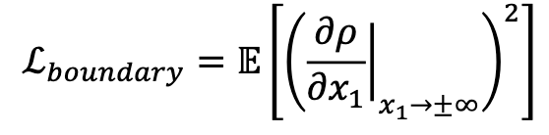
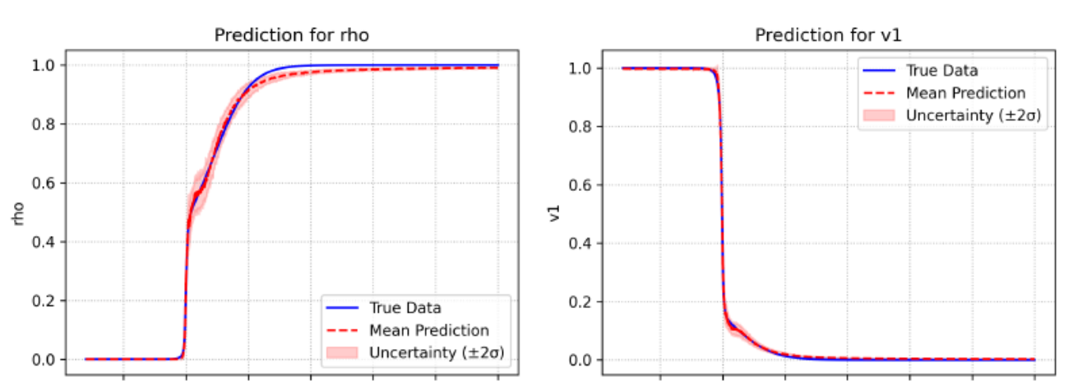
Polyatomic Rarefied Shock Wave
𝔼 denotes the expectation operator
Gradients must approach zero at infinity. Penalizing non-zero gradients in the far-field
Roohi, E., Shoja-Sani, A., Goshayeshi, B. and Peyvan, A., 2025. Learning Rarefied Gas Dynamics with Physics-Enforced Neural Networks. arXiv preprint arXiv:2509.06231.

Slide 12
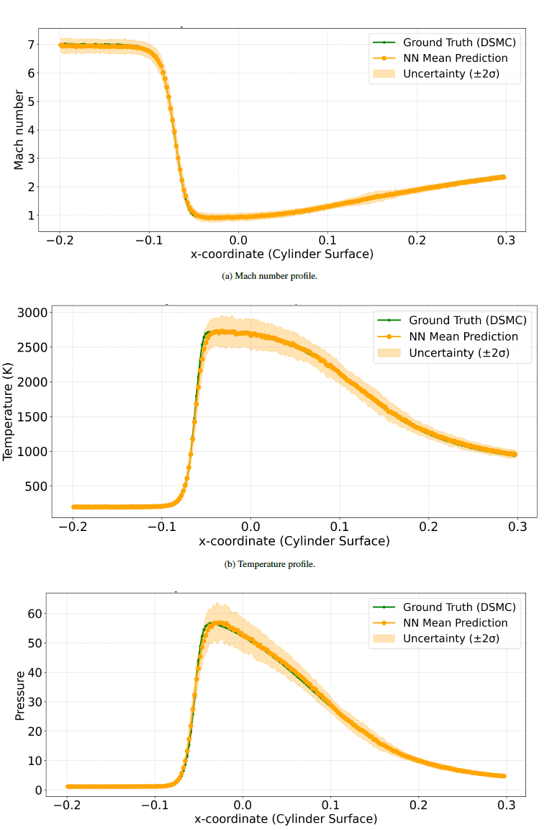
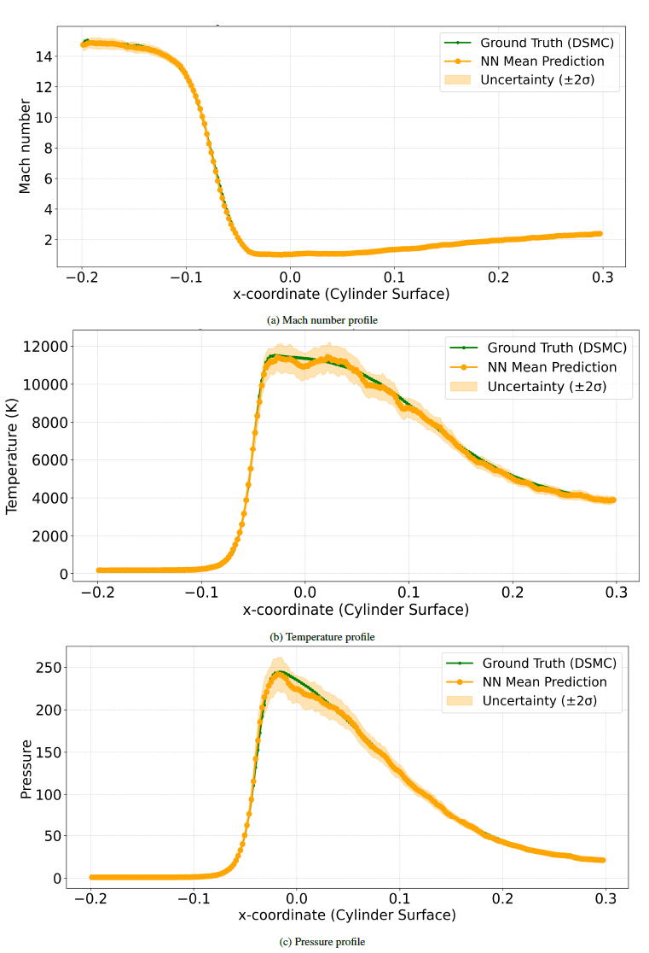
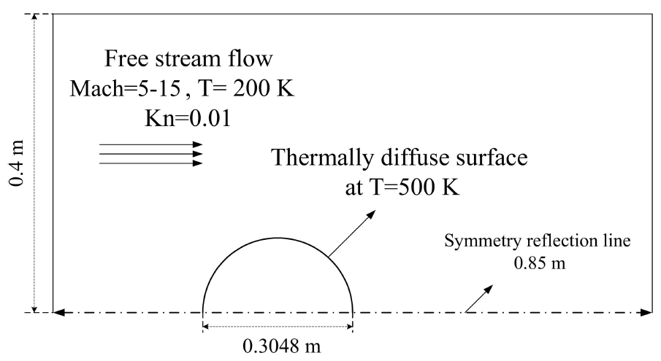
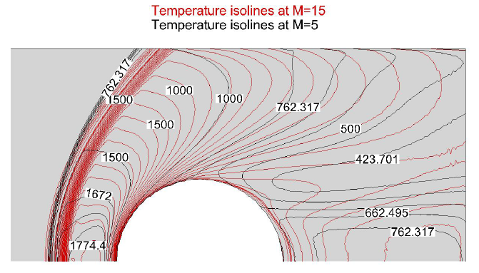
Rarefied Hypersonic Cylinder Flow
M=7
M=15

Slide 13
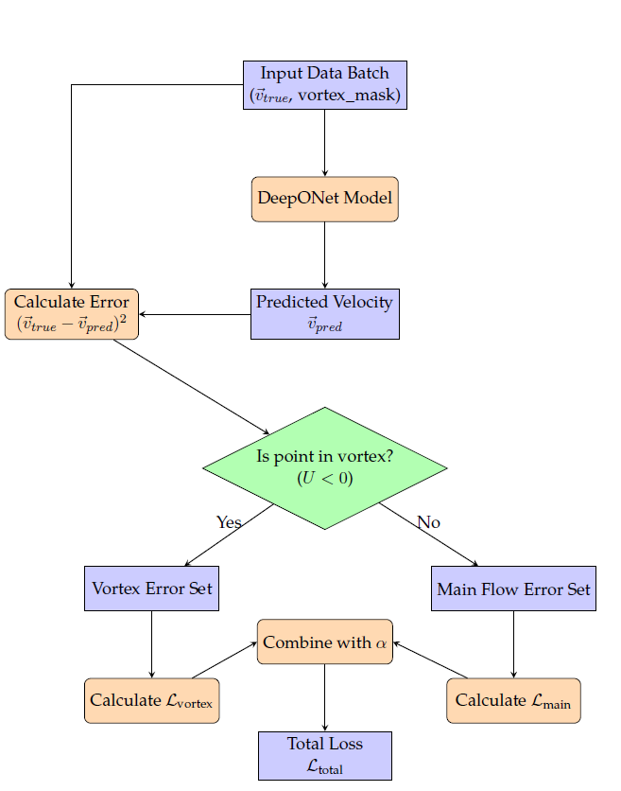
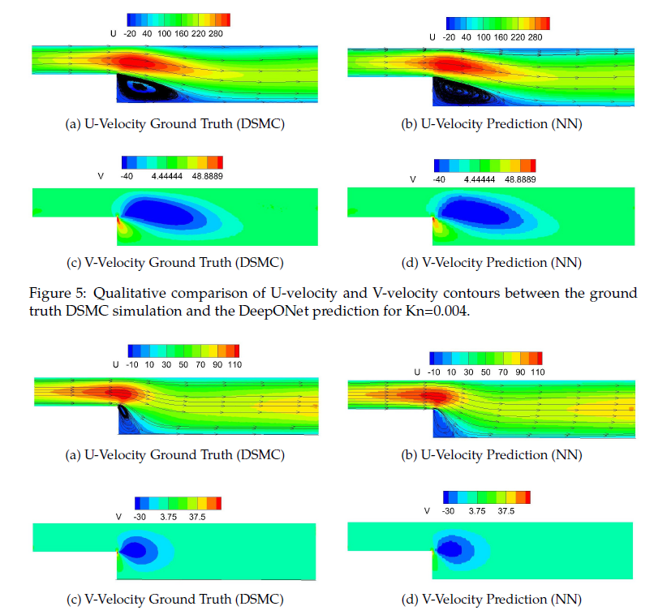
Rarefied Micro-Step Flow: Kn Effect
Kn=0.004
Kn=0.02
Roohi, E., & Mahdavi, A. (2025). Analysis of the Rarefied Flow at Micro-Step using a DeepONet Surrogate Model with a Physics-Guided Zonal Loss Function. arXiv preprint arXiv:2509.17254

Slide 14
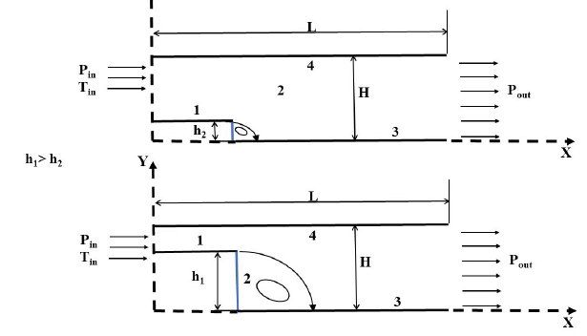
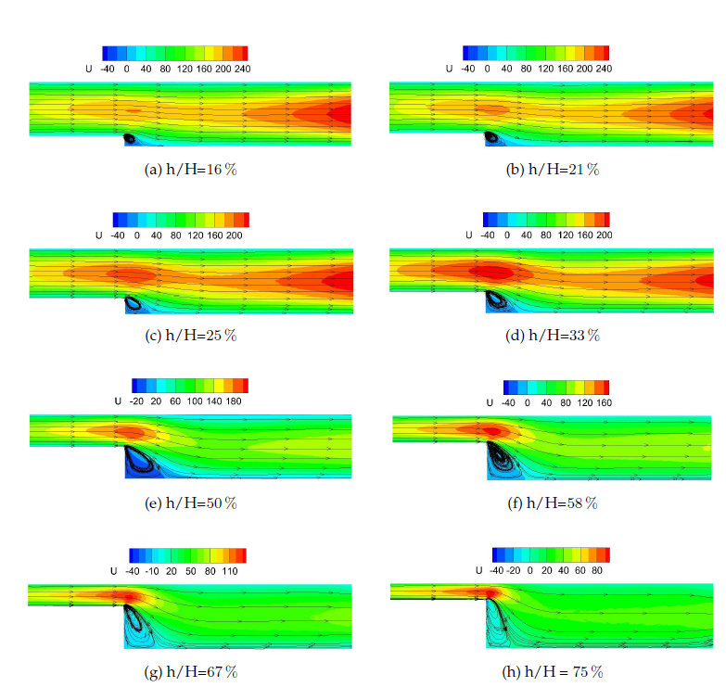
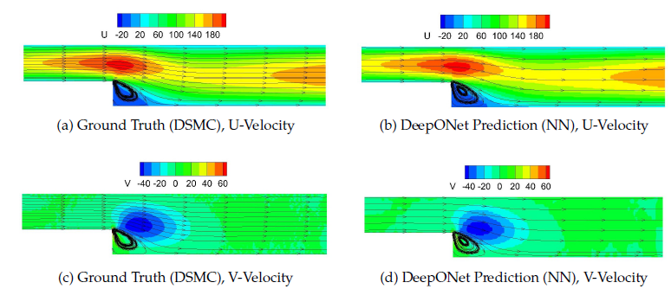
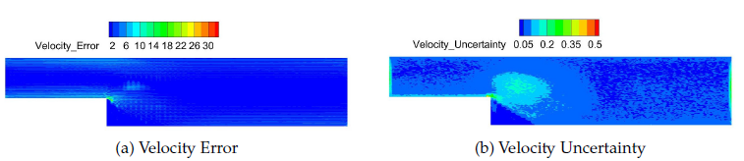
Rarefied Micro-Step Flow: Height Effect

Slide 15
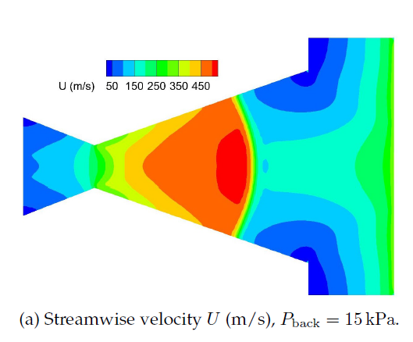
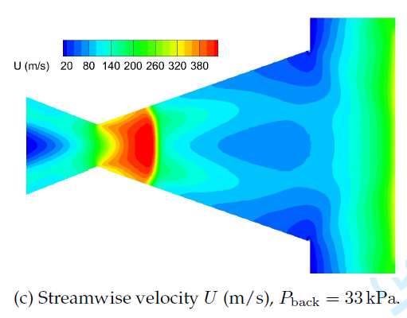
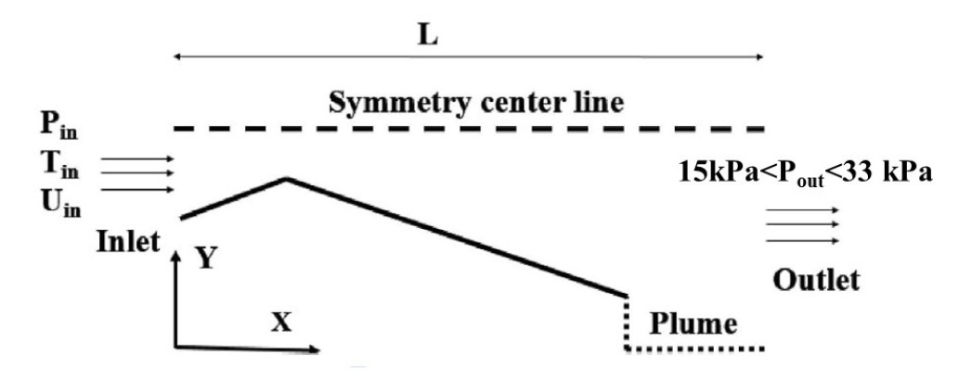
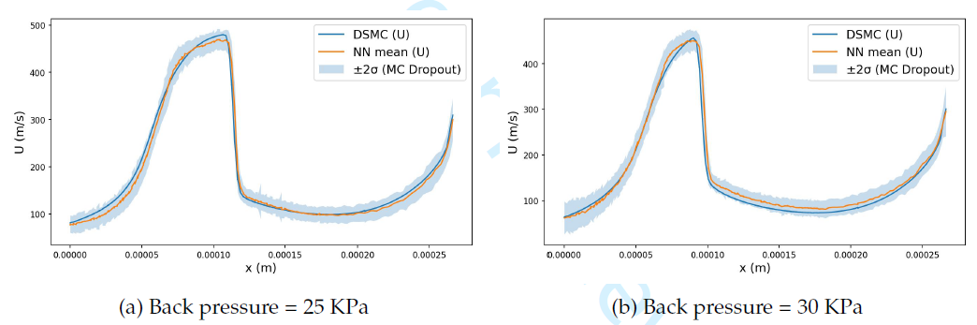
Rarefied Nozzle Flow: Back Pressure Effect

Slide 16
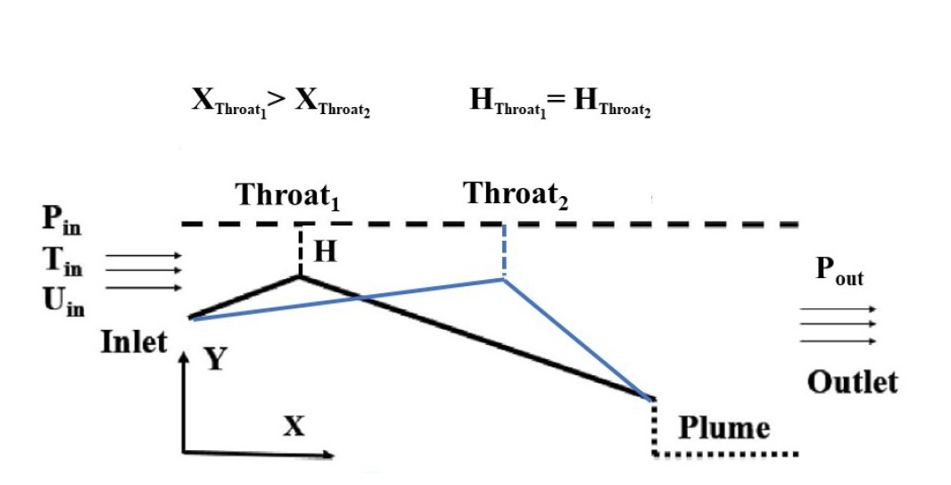
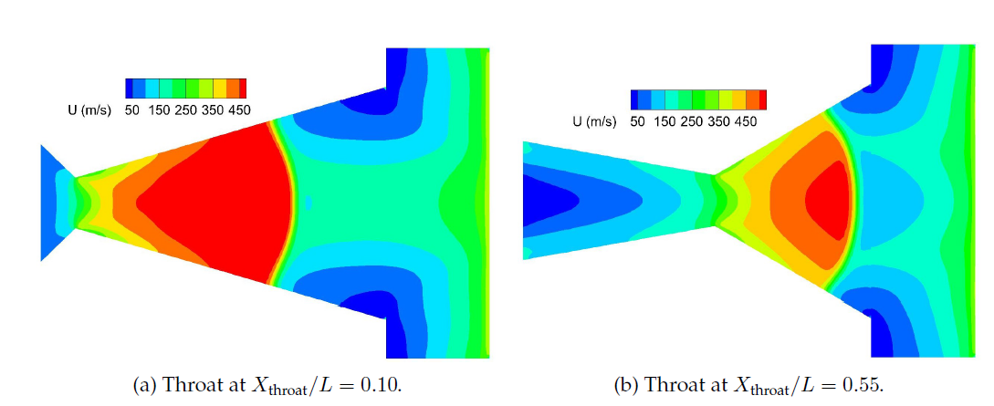
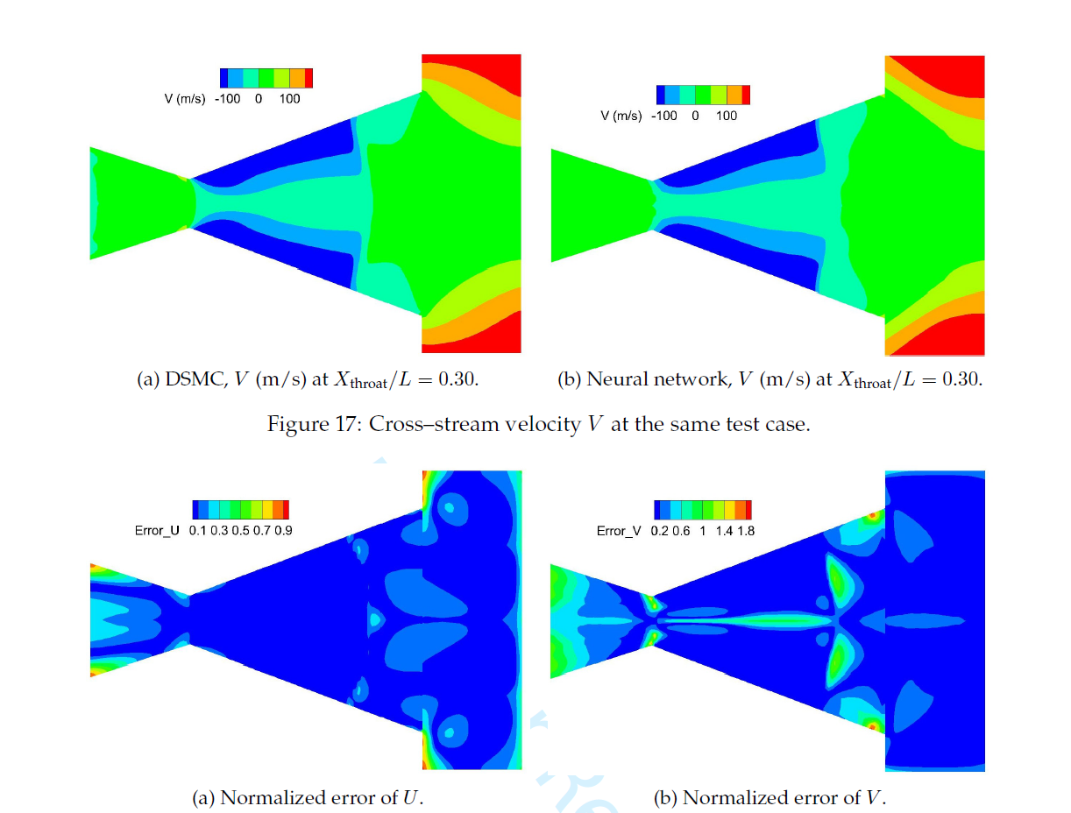
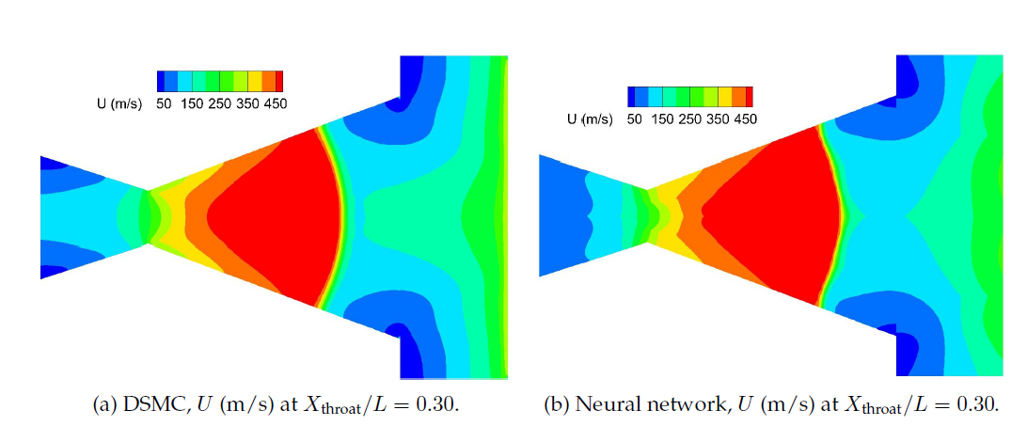
Rarefied Nozzle Flow: Throat Location Effect

Slide 17
Thank You!
Questions

